Slide 1

Chapter 1
Sequence

Slide 2
Content
Back in time...
Why Python?
The concept of sequence
Variables and their data type
Conversion functions
Operators
Functions print() and input()

Slide 3
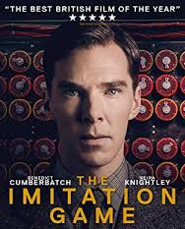
Going back in time...
First computers were "fixed program computers"
This means machines that can run 1 specific program or algorithm
Most famous example is Alan Turings machine which was able to crack the Enigma code of the Germans during the 2nd World War.

Slide 4
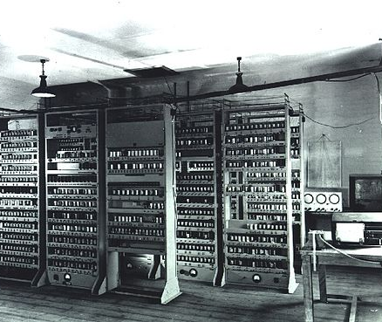
Going back in time...
A breakthrough came with the invention of the "Stored program computers".
Not only the data but also the algorithms are stored in the memory of the computer
In addition, these computers were equipped with a processor or CPU
The CPU is responsible for carrying out calculations and checking the instructions to be carried out sequentially.
This type is known as the Von Neumann machine with as first example the Electronic delay storage automatic calculator (EDSAC) developed in Cambridge

Slide 5
Going back in time...
Each processor has its instruction set or collection of machine codes that can be processed.
Modern processors process up to a few hundred thousand MIPS (Million Instructions Per Second).
Because it is time consuming to write and maintain the instructions to be executed in machine code, assembly and programming languages have been developed.
In assembly languages, each line represents an instruction in machine language
In programming languages the actual machine language is abstracted and encoded in a clear, legible and transparent way
MOV cx,12 Move or place 12 in register cx
number = 12

Slide 6
Going back in time...
The best known higher programming languages
1957 | FORTRAN | Formula Translation, developed by John Backus
1959 | COBOL | Common Business Oriented Language, developed by Grace Hopper
1964 | BASIC | Beginners All Purpose Symbolic Instruction Code, developed by Darmouth College students and refined by Bill Gates and Paul Allen.
1969 | C | Developed by Dennis Ritchie at Bell Telephone as the successor of B to drive the Unix Operating System. Linux is based on C.
1970 | PASCAL | Developed by Niklaus Wirth for educational purposes. The language is named after Blaise Pascal who invented the first 'calculator' in 1641.
1983 | C++ | Bjarne Stroustrup of Bell Labs expands C into an object-oriented language.
1987 | PERL | Practical Extraction Reporting Language, developed by Larry Wall. Perl was Wall's reaction to the fact that a number of standard reports with existing Unix commands could not be realized.

Slide 7
Going back in time...
1991 | PYTHON | Developed by Guido van Rossum, working in "Centre for Mathematics and Computer Science" in the Netherlands as an extension to the language 'ABC'. Python owes its name to Monty Python, Guido van Rossum's favourite TV program.
1992 | VB | Visual Basic. Language released by Microsoft for building graphical window applications.
1993 | RUBY | Yukihirio Matsumoto developed Ruby by combining the languages Perl, Ada, Lisp, Smalltalk and Eiffel.
1995 | PHP | Rasmus Lendorf developed PHP to replace a number of Perl scripts that supported his homepage.
1995 | JAVA | Developed by Sun Microsystem developers led by James Goslin.
1995 | JAVASCRIPT | Developed by Brendan Eich of Netscape under the name Mocha. Language for client-side scripting. Is based on C and is not related to Java.
2001 | C# | Developed by Microsoft as part of .NET. C# is object-oriented and is Microsoft's response to Java.

Slide 8
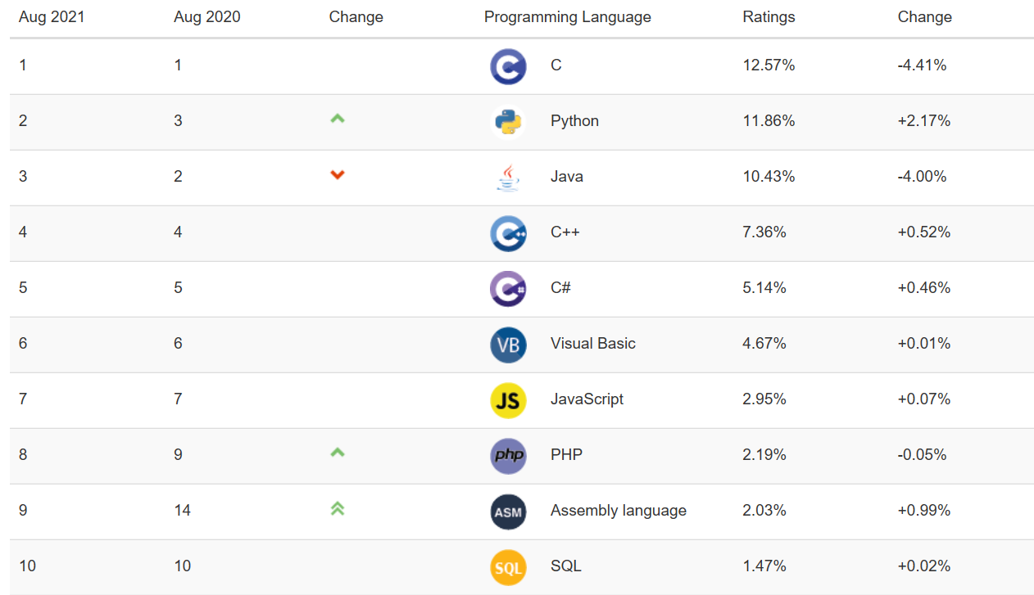
Most popular programming languages today
The TIOBE-Programming Community index reflects the popularity of programming languages.

Slide 9
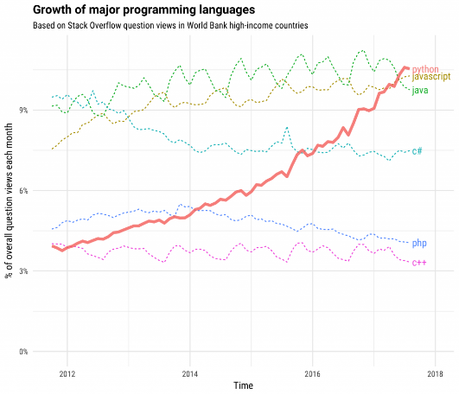
Use of Python
2017, 'Python' was the most frequently entered tag on Stack Overflow.
The rise of Python is impressive as Python was still at the bottom of the top 5 in 2012.

Slide 10
Sequence
Each program consists of a sequence of steps or statements to be performed.
When the program executes each of these statements one after the other, we call it a sequential program.
You can compare this way of coding with following a recipe from a cookbook. You carry out all the steps (weighing ingredients, melting butter, mixing, baking, ...) one by one.
statement
statement
statement

Slide 11
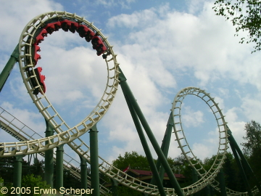
Example: roller coaster.py
Calculate the average speed of the Python roller coaster in the Efteling
Length of the roller coaster = 750m
Duration of the trip = 2 minutes

Slide 12

roller_coaster.py
Code:
Result:
length_in_km = 0.750 time_in_hours = 2/60 speed = length_in_km/time_in_hours print('The average speed of the Python is ' + str(speed) + ' km/h')

Slide 13
roller coaster.py
length_in_km = 0.750 time_in_hours = 2/60 speed = length_in_km/time_in_hours print('The average speed of the Python is ' + str(speed) + ' km/h')
length_in_km
time_in_hours
speed
variables
/ real division
+ addition
see further
/
+
operators
print (argument)
str (argument)
functions
Notes:
/ real division

Slide 14
Variables
Programs process data.
Data is stored in the computer's working memory.
The memory can be compared to a huge wall of mailboxes in which you can post mail.
If these mailboxes do not carry labels with an address, then it is an impossible task to post each letter correctly.
In the same way, it is necessary that every data stored in memory is given a label (an address): the variable!
The variable refers to a value in memory via the assignment operator (=).

Slide 15
Naming variables
We work according to the 'Google Style Guide' for Python:
Variables start with a letter
Variables consist only of lower case letters, numbers and underscores (_)
No abbreviations are used
Underscores are used to separate words
Use (long) meaningful names

Slide 16
Schematic
Variables in the program
Locations in working memory
=
float
length_in_km
0.750
float
time_in_hours
2/60
string
roller_coaster
python
length_in_km = 0.750 time_in_hours = 2/60 roller_coaster = "python"

Slide 17
Data type of a variable
Each variable refers to a value in memory
This value is always of a certain type
You can query the type with the function type()
Variable |  | Data type | Meaning
number = 5 | type(number) | int | Integer - Whole number
pi = 3.14159 | type(pi) | float | Floating Point - Real number
name = "Bob" or name = 'Bob' | type(name) | str | String - Text
success = True | type(success) | bool | Boolean - True of False

Slide 18
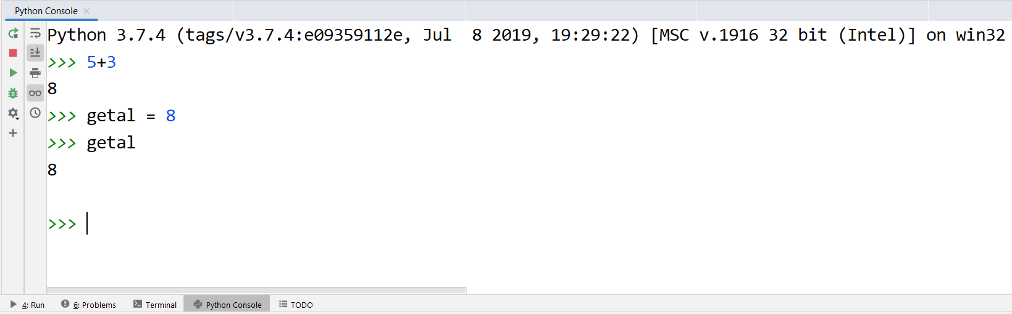
Python Console
To quickly test the capabilities of Python, you do not always need to write a full program.
You can also enter statements directly into the Python Console (click on Python Console at the bottom left).
Attention! These statements will not be kept.
If you see >>> before a statement in the slides,
it means it's entered in the console.

Slide 19
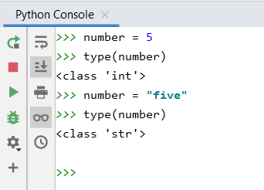
Dynamic typing
Attention! The data type of a variable can change throughout a program.
Variable in the program
Locations in working memory
=
int
number
5
string
five

Slide 20
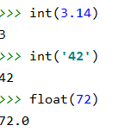
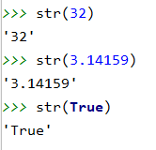
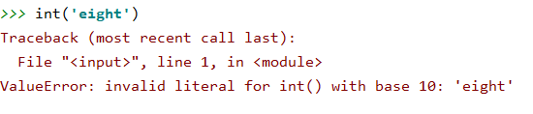
Type conversions
Each Python data type has a function that converts an argument to this data type
int(argument) converts argument to data type int
float(argument) converts argument to data type float
str(argument) converts argument to data type str
If the argument cannot be converted to the data type you will get an error 'at runtime'.

Slide 21
Type conversions
length_in_km = 0.750 time_in_hours = 2/60 speed = length_in_km/time_in_hours print('The average speed of the Python is ' + str(speed) + ' km/h')
str(speed) changes data type from float to string This conversion is necessary because the print function can only print strings!

Slide 22
Arithmetic operators
operator | description
() | parentheses
** | power
+x -x | positive, negative number
* / // % | multiplication, real division, whole division, remainder
+ - | addition, subtraction
Operators are listed in the table according to the respected order of operations. Operations are performed from left to right.

Slide 23
Arithmetic operators
Order of operations is respected
Note that the result of a real division ( / ) is always a real number (datatype float)
>>> 1+2*3/4
2.5
>>> (1+2)*3/4
2.25
>>> 3**2/3
3.0

Slide 24
Division
Python distinguishes real division from whole division
operator / calculates real division (always produces float)
operator // calculates quotient (whole division)
modulo operator % calculates remainder after (whole) division
>>> 83 / 10 # real division
8.3
>>> 83 // 10 # whole division
8
>>> 83.0 // 10 # whole division
8.0
>>> 83 // 10.0 # whole division
8.0
>>> 83 % 10 # remainder after division (modulo)
3
8

Slide 25
Operators for strings
operator | description
+ | concatenation of strings
* | number of string repeats
length_in_km = 0.750 time_in_hours = 2/60 speed = length_in_km/time_in_hours print('The average speed of the Python is ' + str(speed) + ' km/h')
>>> 'Ha' * 3
HaHaHa

Slide 26
Shorthand operators
Standard operator
Shorthand operator
>> number = 6
>> number = number + 1
>> number
7
>> number = 6
>> number += 1
>> number
7
>> number = 4
>> number = number * 2
>> number
8
>> number = 4
>>> number *= 2
>> number
8
>> text = "Python"
>> text = text + " rules the world!"
>> text
'Python rules the world!'
>> text = "Python"
>>> text += " rules the world!"
>> text
'Python rules the world!'

Slide 27
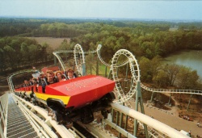
capacity.py
Calculate the capacity per hour of the Python roller coaster in the Efteling at maximum occupancy.
2 trains
28 seats per train
Boarding time = 30 seconds
Duration of the trip = 2 minutes

Slide 28
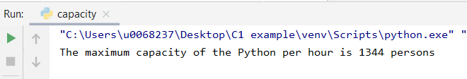
capacity.py
Code:
Result:
places_per_train = 28 trains_per_hour = 2 minutes_per_ride = 2 minutes_boarding_time = 0.5 capacity_per_hour = trains_per_hour * places_per_train
* 60 / (minutes_boarding_time + minutes_per_ride) print('The maximum capacity of the Python per hour is’,
int(capacity_per_hour), 'persons')

Slide 29
capacity.py
print('The maximum capacity of the Python per hour is’,
int(capacity_per_hour), 'persons')
An alternative print function is used (comma’s and not +)
The capacity_per_hour is converted to an integer. Otherwise the result would be: 1344.0 persons

Slide 30
capacity.py
Calculate the capacity per hour of the Python roller coaster in the Efteling at maximum occupancy.
2 trains
28 seats per train
Boarding time = 30 seconds
Ride time = 2 minutes
What if the number of seats per train or the number of trains used varies?
Are we going to write a new algorithm every time?
No! The solution is to request the number of seats and the number of trains

Slide 31


Input function
input(argument) built-in keyboard input function
the value entered is captured in a variable
input always returns a string
So, when you request a number, you still have to convert the string you entered using the conversion functions float() or int() before you start calculating with it.
trains_per_hour = input("Enter the number of trains per hour: ") print(type(trains_per_hour))
trains_per_hour = int(input("Enter the number of trains per hour: ")) print(type(trains_per_hour))

Slide 32

capacity.py
Code:
Result:
trains_per_hour = int(input("Enter the number of trains per hour: ")) places_per_train = int(input("Enter the number of places per hour: "))
minutes_per_ride = 2 minutes_boarding_time = 0.5
capacity_per_hour = trains_per_hour * places_per_train * 60 / (minutes_boarding_time + minutes_per_ride)
print('The maximum capacity of the Python per hour is', int(capacity_per_hour), 'persons')

Slide 33
Comments in a Python program
Adding comments makes your program more readable for other programmers
In Python
You can
Type # manually
Select lines code > Ctrl + : (in Visual Studio Code)
Uncomment: Select lines code > Ctrl + :
#strings can be with "" or ' text1 = "this is in the morning" text2 = 'start lesson 8:25' #join strings print(text2, text1)

Slide 34
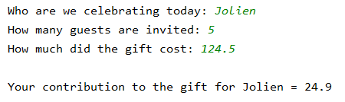
Recap
Many programs have the following structure:
You read data
You process those data
You print the information you obtained
# read data person = input("Who are we celebrating today: ") number_of_guests = int(input("How many guests are invited: ")) price_present = float(input("How much did the gift cost: "))
# process data price_per_guest = price_present/number_of_guests
# print information print("\nYour contribution to the gift for " + person + " = " + str(price_per_guest))

Slide 35
Recap
The new line character in Python is \n .
It is used to indicate the end of a line of text and the beginning of a new line

